Slide 1
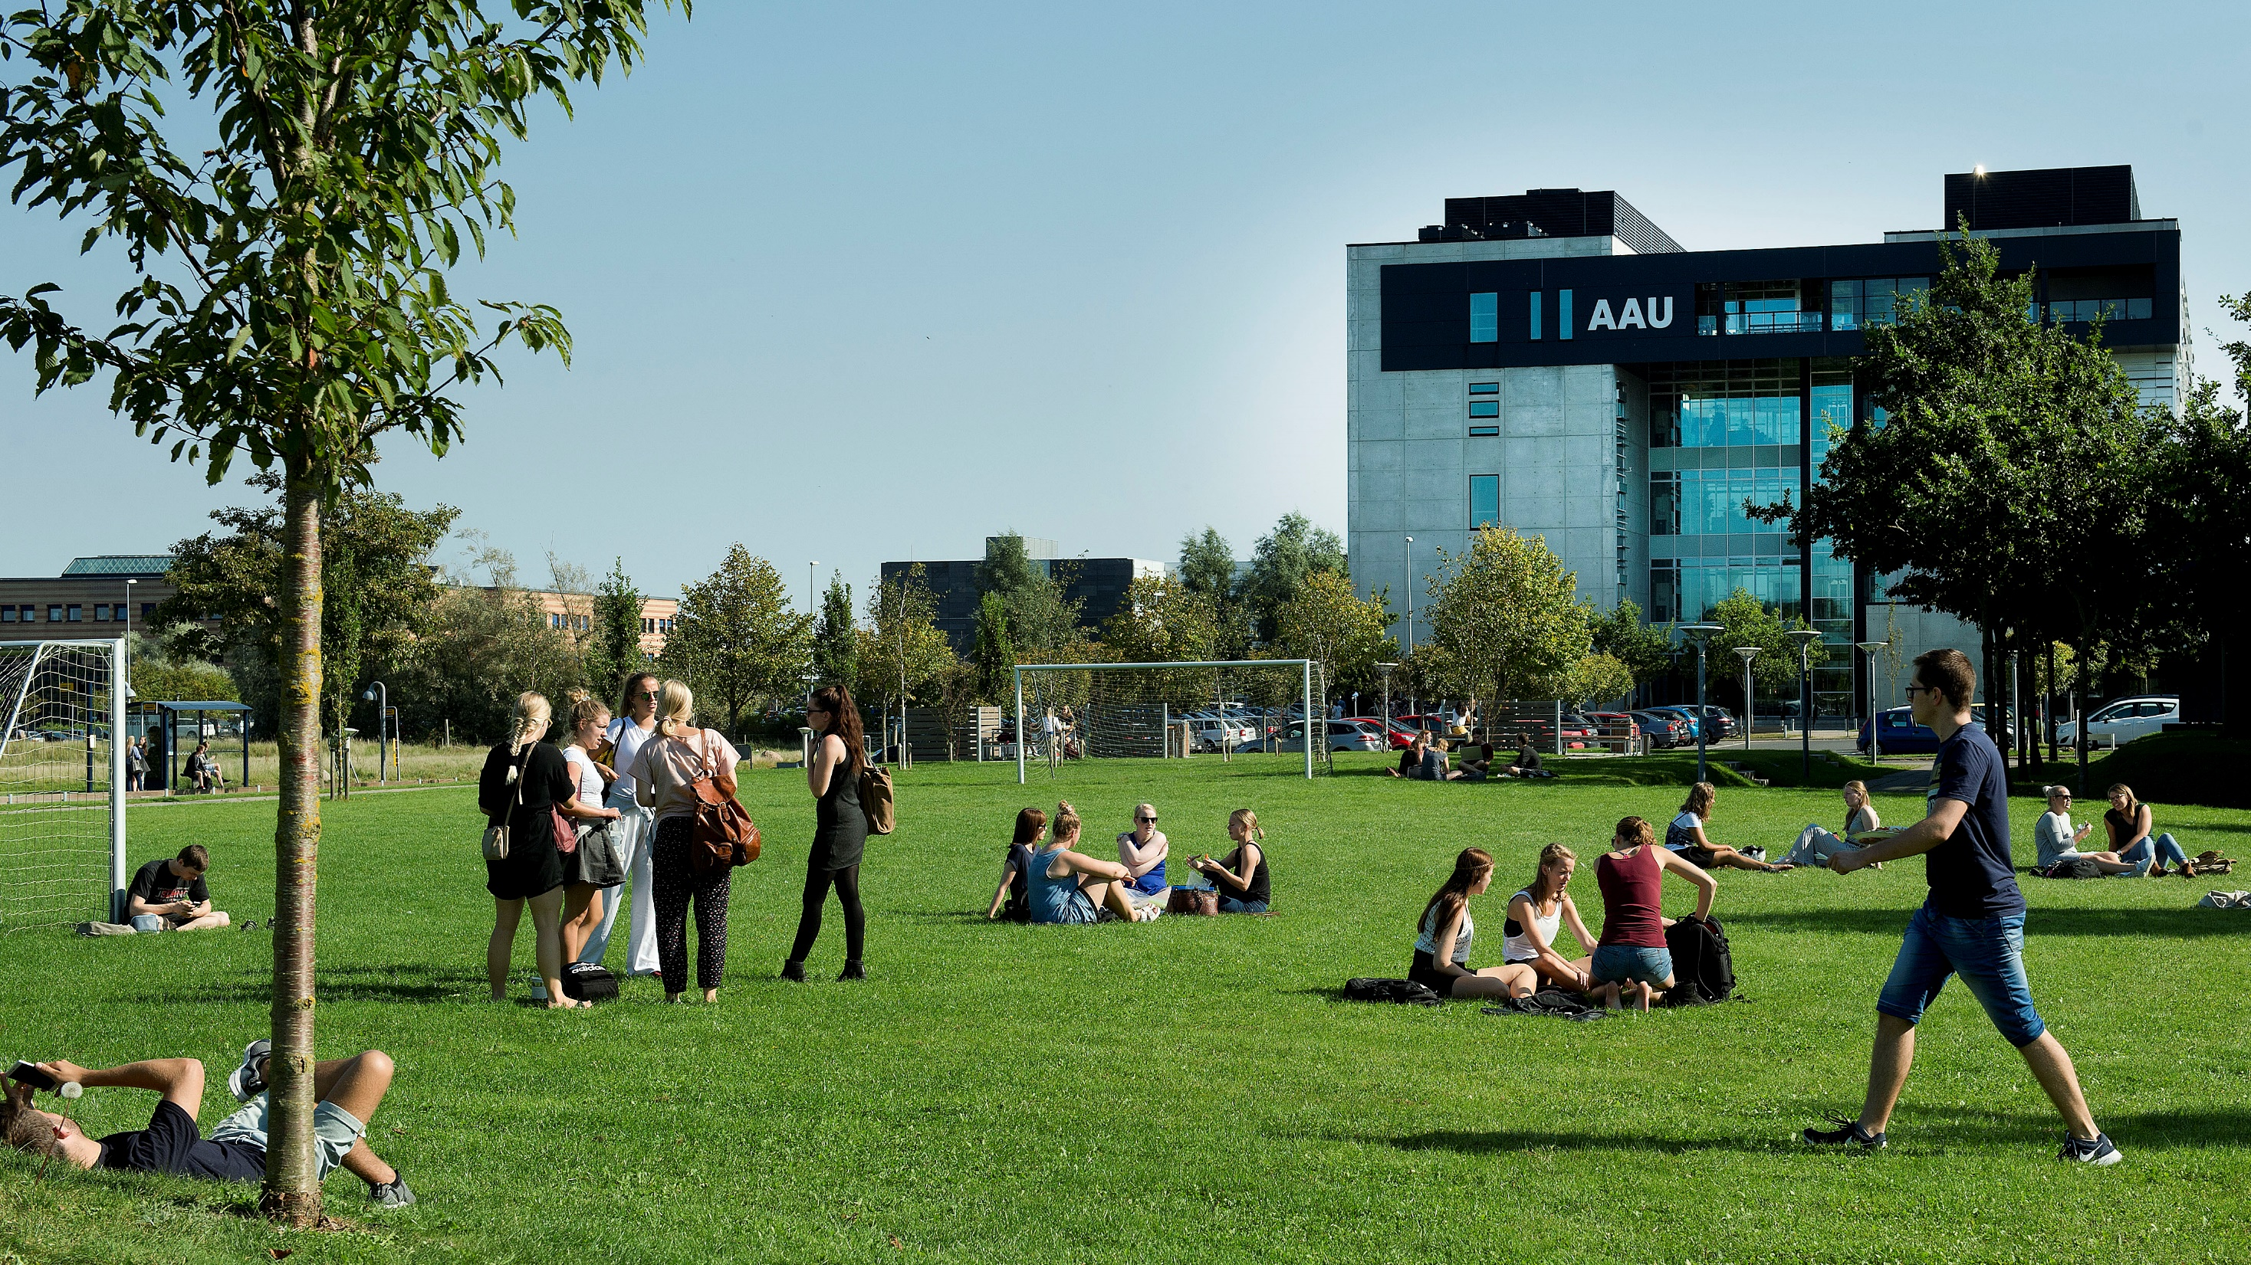
Questions
Group 670

Slide 2

CONTENT
GENERAL GUIDELINES
STUDENTS
PBL
RESEARCH AND RANKING
BUSINESS COLLABORATION
STRATEGY 2016-21

Slide 3
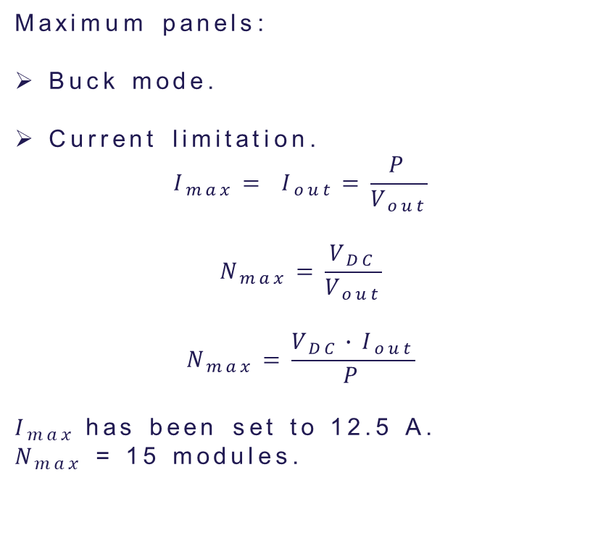
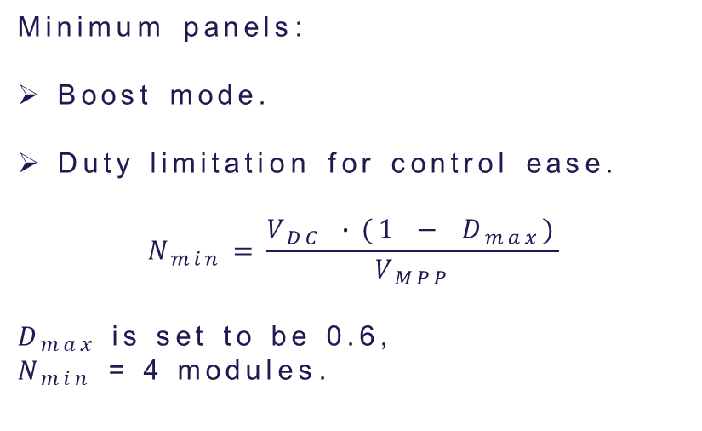
Minimum and maximum number of panels
Maximum panels:
Buck mode.
Current limitation.
$$I_{max}= I_{out}=\frac{P}{V_{out}}$$
$$N_{max}=\frac{V_{DC}}{V_{out}}$$
$$N_{max}=\frac{V_{DC}∙I_{out}}{P}$$
$I_{max}$has been set to 12.5 A.
$N_{max}$ = 15 modules.
Minimum panels:
Boost mode.
Duty limitation for control ease.
$$N_{min}=\frac{V_{DC} ∙(1 − D_{max})}{V_{MPP}}$$
$D_{max}$ is set to be 0.6,
$N_{min}$ = 4 modules.

Slide 4
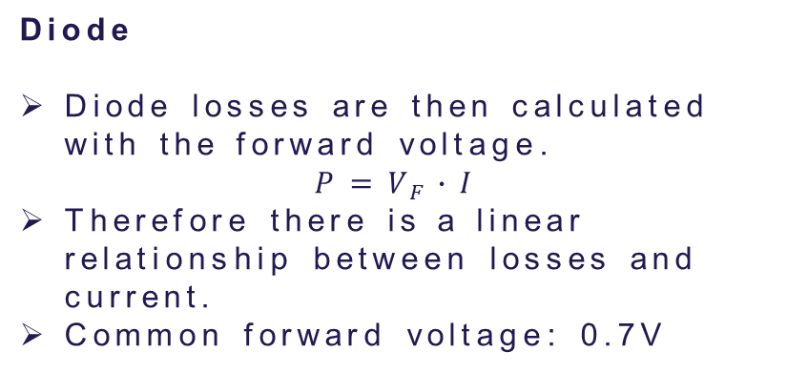
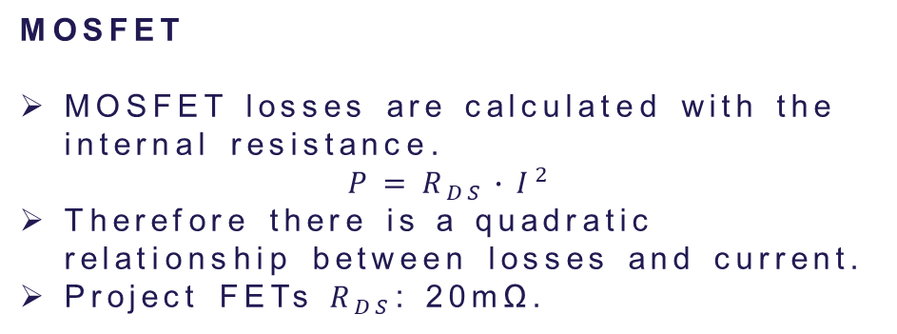
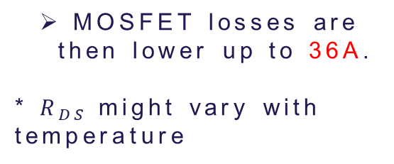
Why are there more losses in diodes than MOSFETs
Diode
Diode losses are then calculated with the forward voltage.
$$P=V_{F}∙I$$
Therefore there is a linear relationship between losses and current.
Common forward voltage: 0.7V
MOSFET
MOSFET losses are calculated with the internal resistance.
$$P=R_{DS}∙I^{2}$$
Therefore there is a quadratic relationship between losses and current.
Project FETs $R_{DS}$: 20mΩ.
MOSFET losses are then lower up to 36A.
* $R_{DS}$might vary with temperature

Slide 5
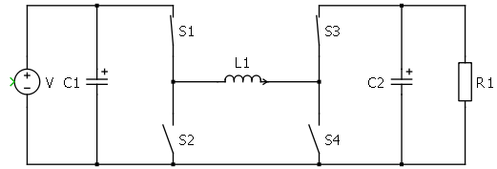
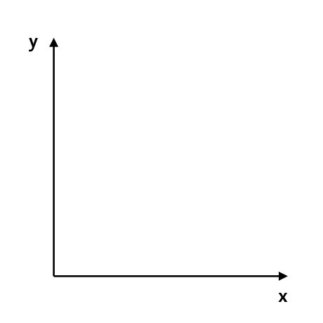


DCM
MOSFETs do not prevent reverse current like a diode would.
DCM mode is never reached when working with the 4 transistors.
Instead current would be negative through the couil.
$$I_{L}$$
$$t$$

Slide 6
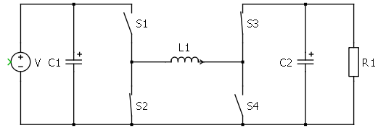
DCM
MOSFETs do not prevent reverse current like a diode would.
DCM mode is never reached when working with the 4 transistors.
Instead current would be negative through the couil.
$$I_{L}$$
$$t$$

Slide 7
DCM
MOSFETs do not prevent reverse current like a diode would.
DCM mode is never reached when working with the 4 transistors.
Instead current would be negative through the couil.
$$I_{L}$$
$$t$$

Slide 8
DCM
MOSFETs do not prevent reverse current like a diode would.
DCM mode is never reached when working with the 4 transistors.
Instead current would be negative through the couil.
$$I_{L}$$
$$t$$

Slide 9
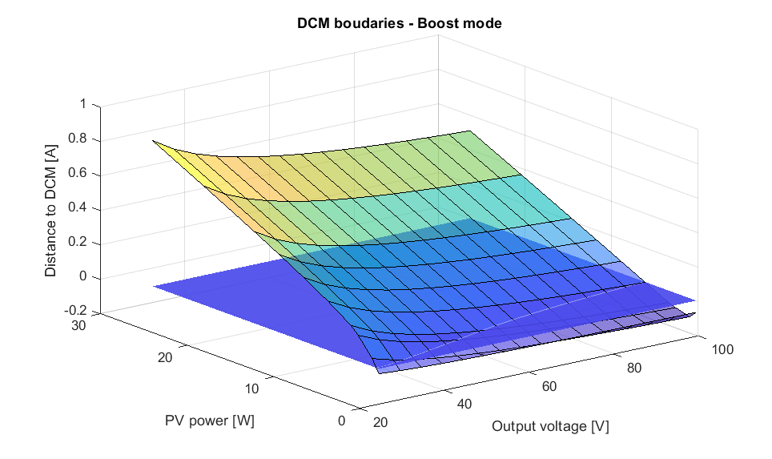
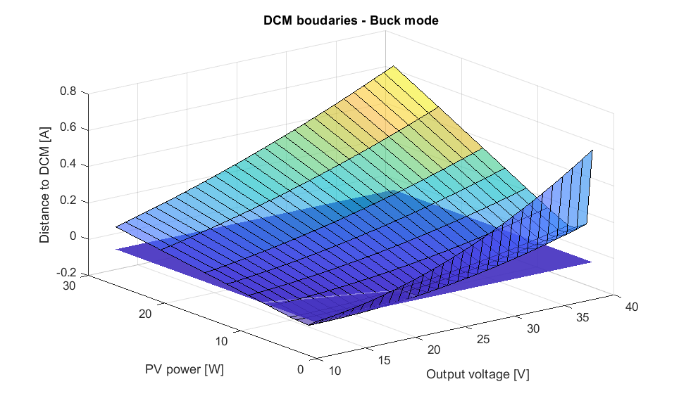
DCM
DCM mode depends on output voltage and power generated.

Slide 10
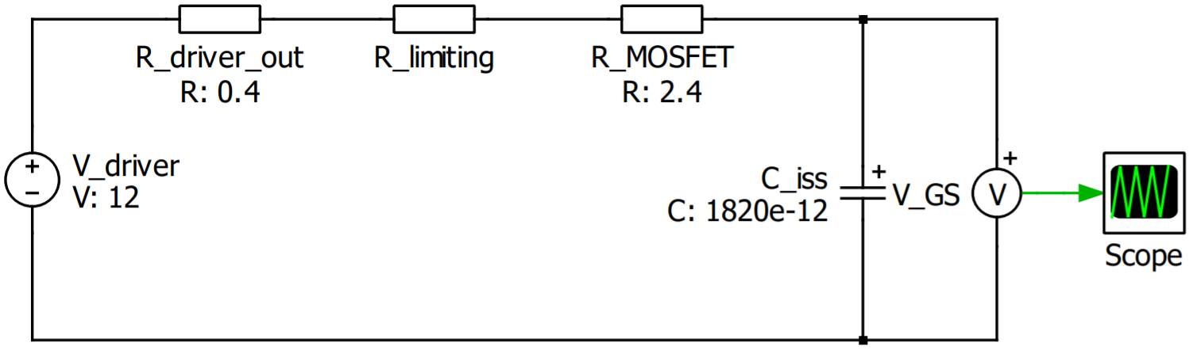

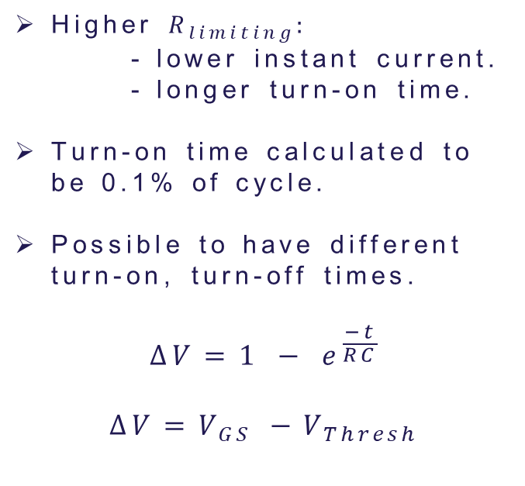
Limiting resistance
OUT H
$$R_{limiting}$$
Higher $R_{limiting}:$
- lower instant current.
- longer turn-on time.
Turn-on time calculated to be 0.1% of cycle.
Possible to have different turn-on, turn-off times.
$$∆V=1 − e^{\frac{−t}{RC}}$$
$$∆V=V_{GS} −V_{Thresh}$$
PWM
DRV
OUT L

Slide 11
Time Management Table
Name | Time holding breath under water | Time without criticizing work | Time used for eating
Nicolai | 29:10 | 29:10 | 20:00
Thassilo | 10:02 | 10:02 | 20:00
Aitor | 00:17 | 00:17 | 20:00
Nicolas | 19:57 | 00:00 | ∞

Slide 12
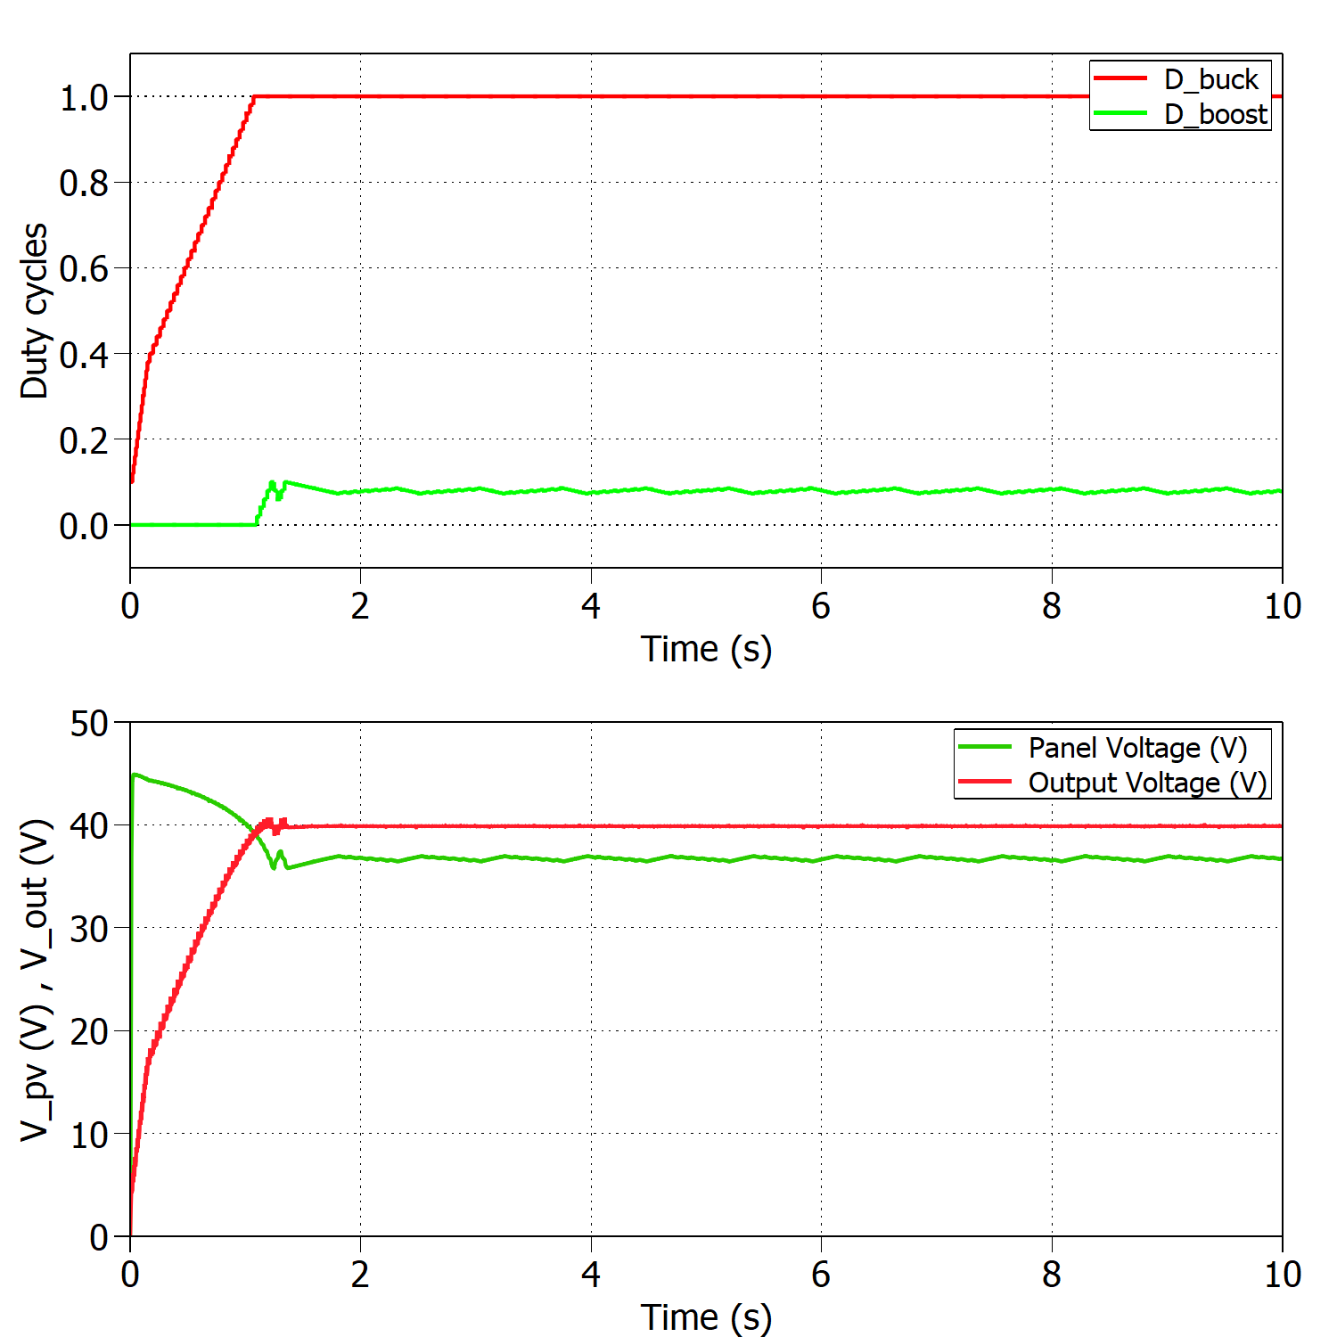
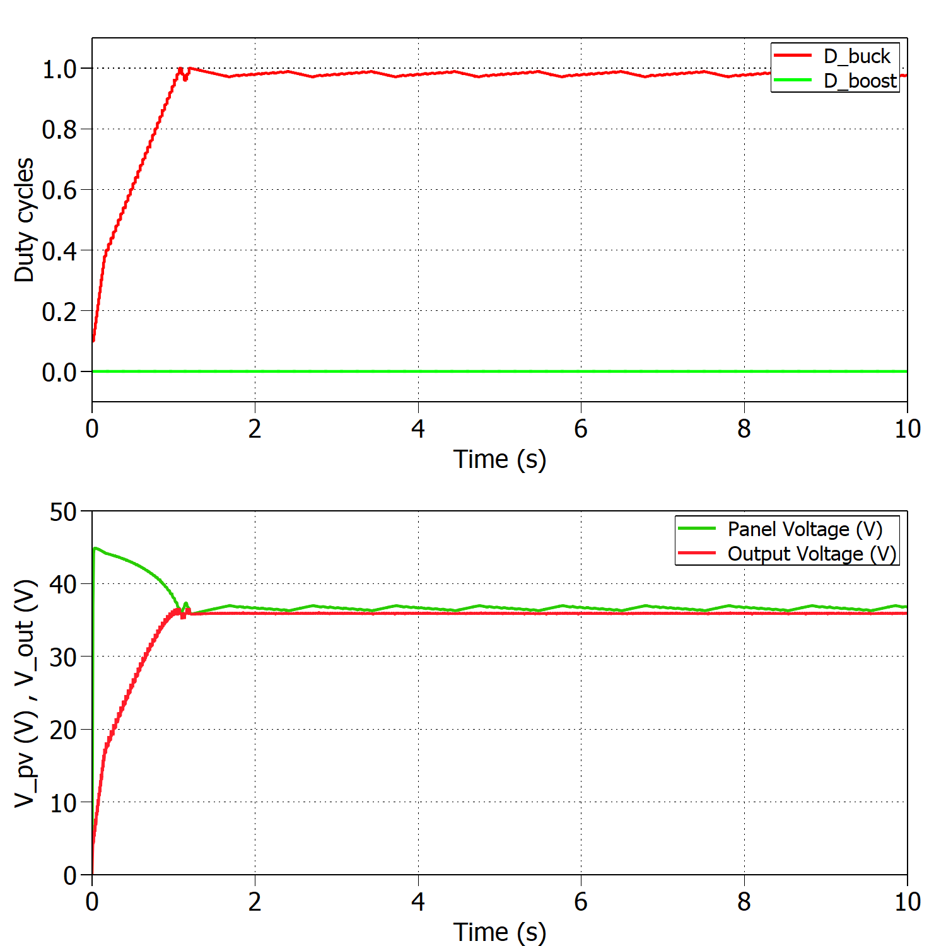
Time Management Table
Add a nice looking caption if you have multiple figures at one slide
And make sure that they are better aligned than this…

Slide 13
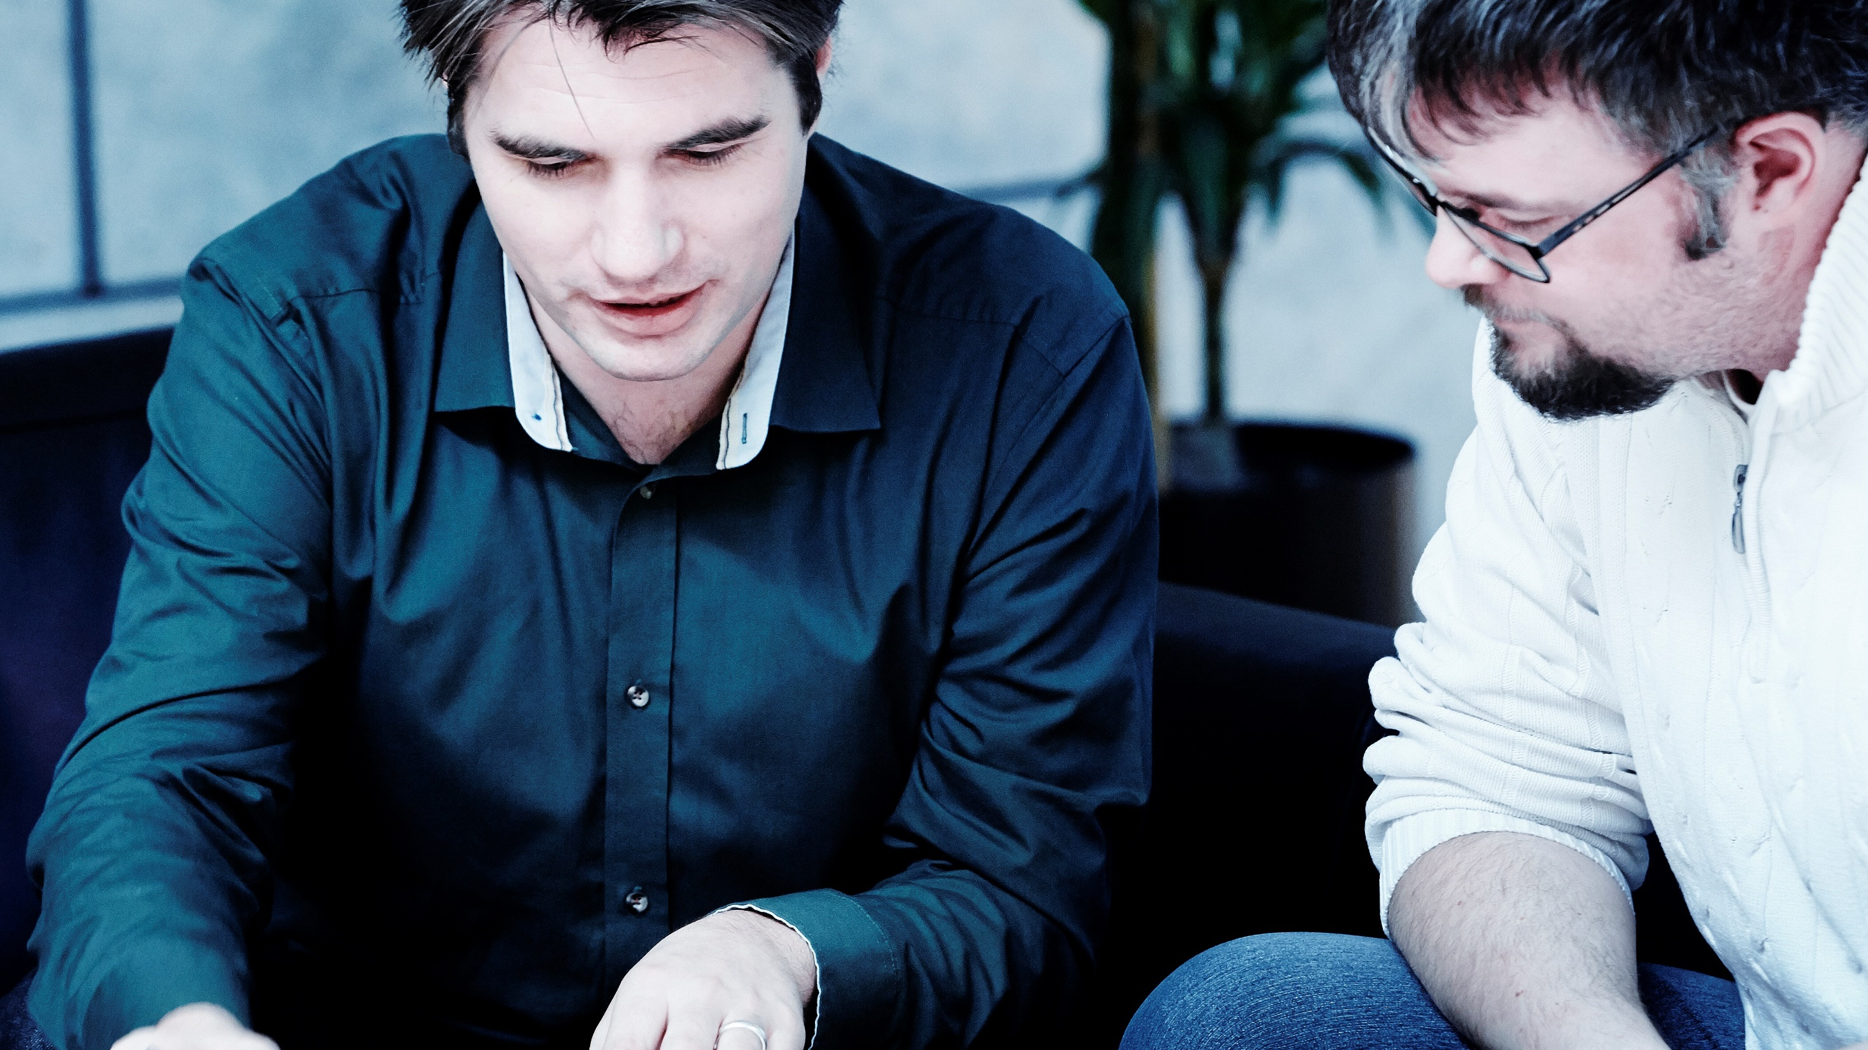
Converter design, change random picture

Slide 14
Converter design, change random picture

Slide 15
Converter design, change random picture

Slide 16
Converter design, change random picture

Slide 17
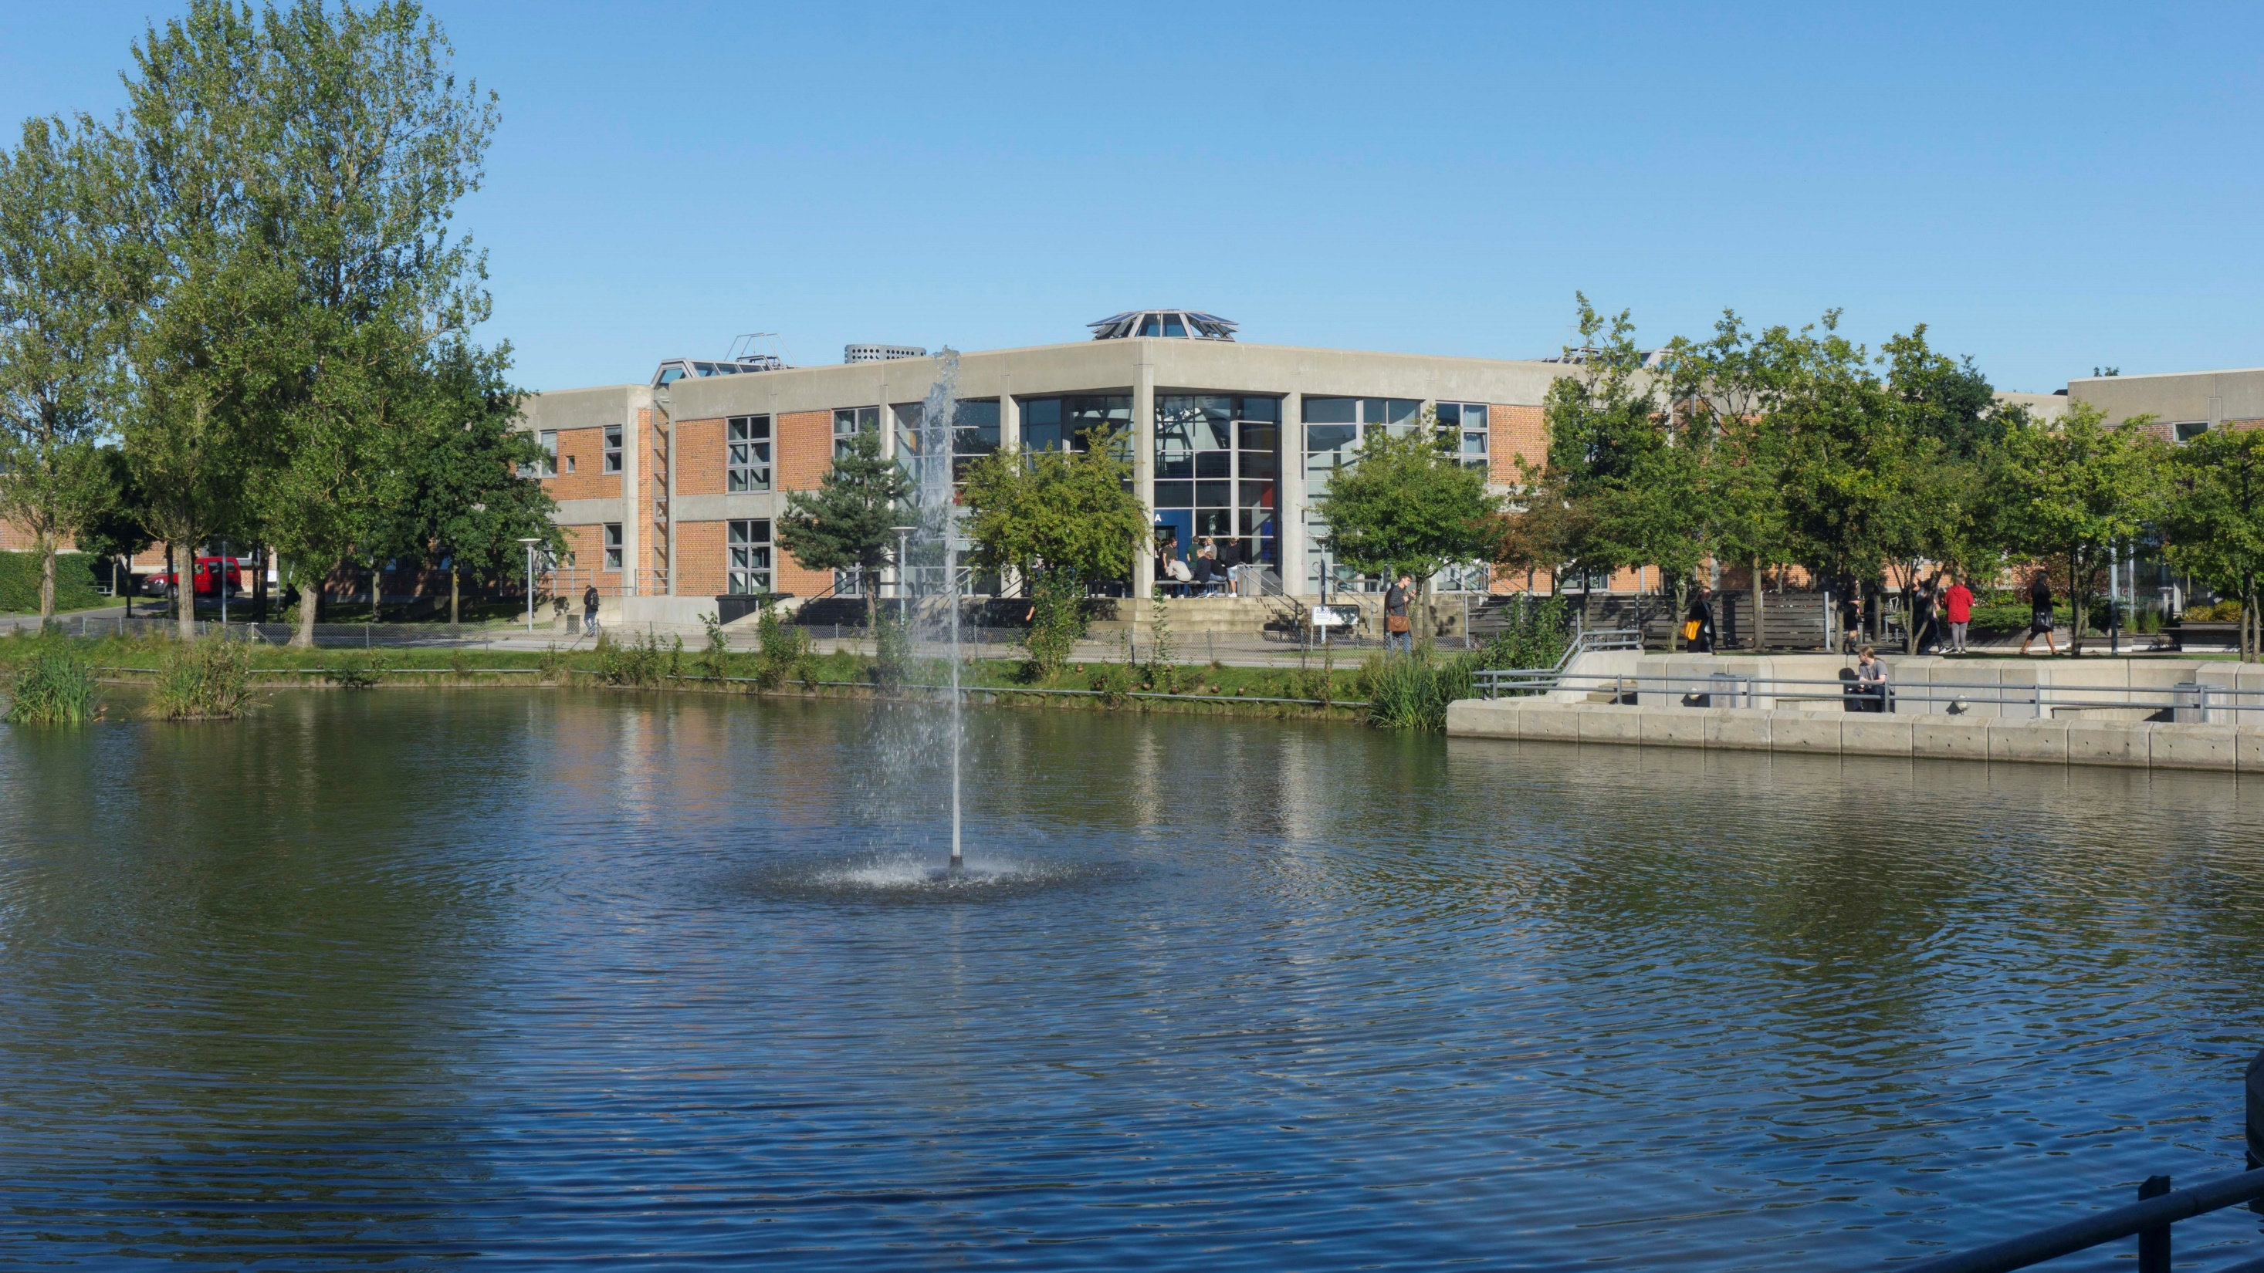
Thank you for your attention
Questions?

